Slide 1
PARTICLES SIMULATION AND APPLICATIONS TO RESEARCH
By Dr. Wirin Sonsrettee and
Dr. Achara Seripienlert

Slide 2
OUTLINE
Introduction
Solar Activities
Solar Energetic Particles
Interplanetary Magnetic Field
Two-Component Magnetic Turbulence Model
Numerical Simulations → Streamline Code
Applications to Research

Slide 4
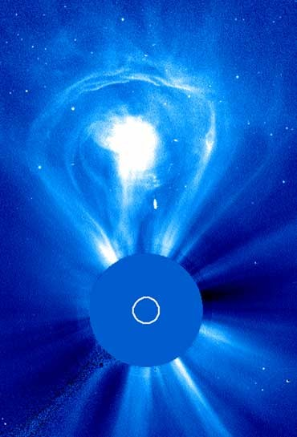
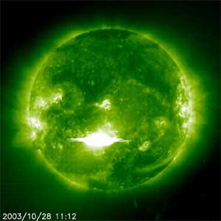
Solar events due to active regions
Solar flares
Impulsive flares
Gradual flares
Coronal Mass Ejection
(CME)
Solar storms
CME
SUN (blocked)
Image credit: http://pharyngula.org/images/flare281003.jpg
CME on February 27, 2000.
Image Credit: SOHO, ESO
and NASA

Slide 5
Solar Energetic Particles

Slide 6
Solar Wind

Slide 7
Interplanetary Magnetic Field

Slide 8
Our work is to study mechanism of particles transport along interplanetary magnetic field.

Slide 9
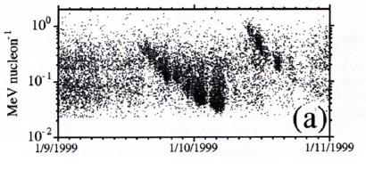
ACE spacecraft measured “dropouts”
Mazur et al. 2000
Image credit: Mazur et al. 2000

Slide 10
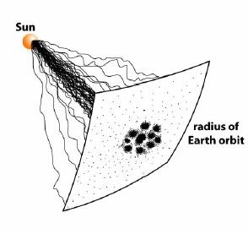
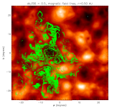
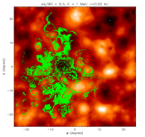
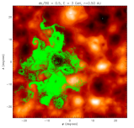
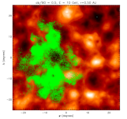
The dropout phenomena of SEP transport can be explained by the idea of conditional statistics of magnetic field lines.
Ruffolo et al. 2003
1.0 AU
Image credit: Ruffolo et al. 2003

Slide 11
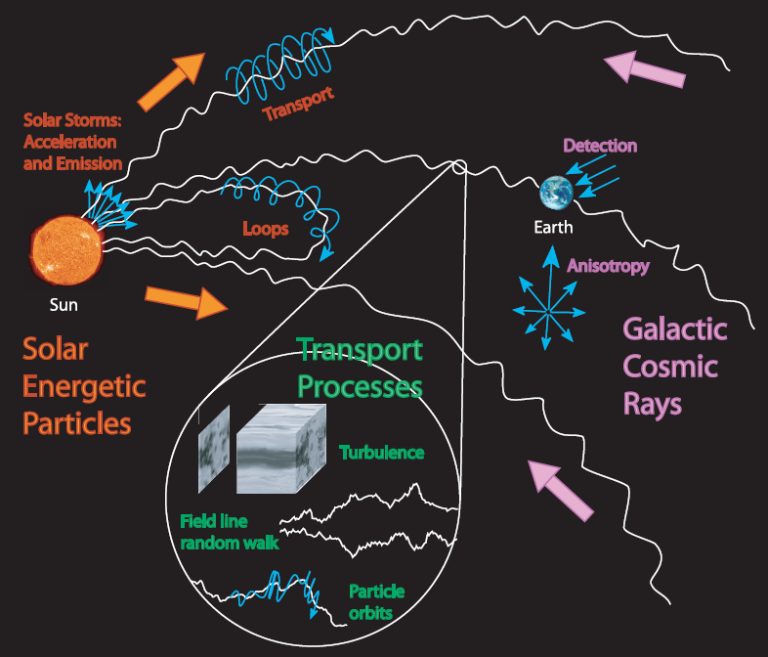
ทดลองและใช้คอมฯ วิเคราะห์ข้อมูล
ใช้คอมฯวิเคราะห์ข้อมูล
ทฤษฎีและคอมฯ

Slide 12
INTERPLANETARY MAGNETIC FIELD (IMF)

Slide 13
INTERPLANETARY MAGNETIC FIELD (IMF)

Slide 14
Introduction to Turbulence
A Flow: the continuous fluid movement from one place to another.
2 types of flows: Laminar VS Turbulence
simple flows complicated flow

Slide 15
Image credit: http://www.cora.nwra.com/~werne/eos/images/turbulent.jpg

Slide 16
Definition of Turbulence
Turbulence is a type of flow that can occur in any fluid involving swirling motions over a wide range of length scales.
Examples:
Water dropping into a basin
Bullet moving through air
In plasma
Almost any space plasma, e.g. the solar wind.

Slide 17
Research at MU
Effect of plasma turbulence on particle motion
Magnetic field random walk
Magnetic field line separation

Slide 18
Conditions for Turbulence
Irregularity
3D vorticity fluctuations
Diffusivity
High Reynolds number
Energy input & Energy dissipation
Continuum
Turbulence is initiated by random perturbation and instabilities.
Velocity scale
Length scale
Molecular viscosity
Energy lost from viscosity
Scales large enough to see fluid as continuum

Slide 19
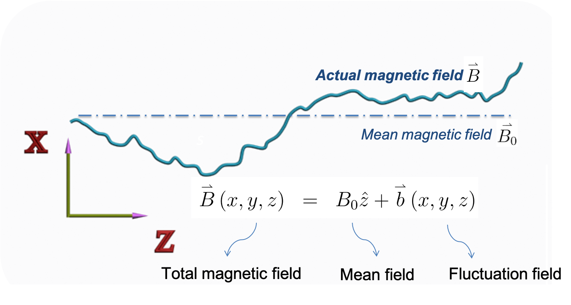
Magnetic Field Turbulence

Slide 20
Particle in a Uniform Magnetic Field
Magnetic Field
$$\overset{⃑}{B}=B_{0}\hat{z}$$
Newton–Lorentz equation (cgs unit)
$$\overset{⃑}{F}=\frac{q\overset{⃑}{v}×\overset{⃑}{B}}{c}$$
Equations of Motion
${\dot{v}}_{x}=Ωv_{y}$ ${\dot{v}}_{y}=−Ωv_{x}$ ${\dot{v}}_{z}=0$
$Ω$=q $B_{0}$/ $γm$c

Slide 21
Particle in a Uniform Magnetic Field
Credit: Shalchi, A. 2009, Nonlinear Cosmic Ray Diffusion Theories.

Slide 22
Particle in a Magnetic Turbulence
Magnetic Field
$\overset{⃑}{B}=B_{0}\hat{z}+b_{x}\hat{x}$+ $b_{y}\hat{y}$ $+b_{z}\hat{z}$
Newton–Lorentz equation (cgs unit)
$$\overset{⃑}{F}=γm\dot{\overset{⃑}{v}=}\frac{q\overset{⃑}{v}×\overset{⃑}{B}}{c}$$
Equations of Motion
$${\dot{v}}_{x}=Ωv_{y}+\left[Ω\left(v_{y}\frac{b_{z}}{B_{0}}−v_{z}\frac{b_{y}}{B_{0}}\right)\right]$$
$${\dot{v}}_{y}=−Ωv_{x}+\left[Ω\left(v_{z}\frac{b_{x}}{B_{0}}−v_{x}\frac{b_{z}}{B_{0}}\right)\right]$$
${\dot{v}}_{z}=\left[Ω\left(v_{x}\frac{b_{y}}{B_{0}}−v_{z}\frac{b_{x}}{B_{0}}\right)\right]$
Notes:
v และ B เป็นค่า random และขึ้นอยู่กับตำแหน่ง

Slide 23
Particle in a Magnetic Turbulence
Credit: Shalchi, A. 2009, Nonlinear Cosmic Ray Diffusion Theories.
Notes:
v และ B เป็นค่า random และขึ้นอยู่กับตำแหน่ง

Slide 24
Diffusion
Diffusion Equation
$\left\langle x^{2}\right\rangle =2Κ_{xx}t≈$ $2Κ_{xx}r$
Diffusion Coefficient
$Κ_{xx} \left(\vec{r}\right)$ $≈\int_{0}^{t}{\left\langle U_{i}({\vec{r}}_{0})U_{j}({\vec{r}}_{0}+\vec{r})\right\rangle d\vec{r}}=$ $\int_{0}^{t}{R_{xx}\left(\vec{r}\right)d\vec{r}}$
$$R_{xx}(r)$$
$$r$$
Notes:
v และ B เป็นค่า random และขึ้นอยู่กับตำแหน่ง

Slide 25
Correlation Function
Correlation function is defined by:
Typically
$$R_{ij}(\vec{r})=\left\langle U_{i}({\vec{r}}_{0})U_{j}({\vec{r}}_{0}+\vec{r})\right\rangle$$
$$R_{ij}(0)=\left\langle U_{i}({\vec{r}}_{0})U_{j}({\vec{r}}_{0})\right\rangle =U^{2}δ_{ij}$$

Slide 26
Power Spectrum
Power spectrum: Fourier Transform of correlation function
$$R_{xx}(r)$$
$$P_{xx}(\vec{k})$$
$$U^{2}$$
$$r$$
$$k$$

Slide 27
Typical turbulence
$$R_{xx}(r)$$
$$\log{P_{xx}}(\vec{k})$$
$$U^{2}$$
$$\log{k}$$
$$r$$

Slide 28
Kolmogorov Theory (1941)
Outer
Scales
Inner
Scales
Inner
Scales
Energy Input
ε
ε
ε
ε
Energy dissipation
Ul >> 1
Ul ~ 1
Ul ~ 1
ν
ν
ν
Flow of energy across scales → Turbulent cascade

Slide 29
What is ε?
U
energy
$$\sim U^{2}$$
mass
$$\sim \frac{ℓ}{U}$$
l
turn over time
$$ε=\frac{energy}{mass⋅time}\sim \frac{U^{3}}{ℓ}$$
As l decreases → U decreases also to maintain a constant ε
$$U^{3}=εℓ,U∝ℓ^{1/3}$$

Slide 30
Correlation length
$$R_{xx}(r)$$
$$U^{2}$$
$$ℓ_{c}=\frac{\int_{0}^{∞}{R_{xx}(r)dr}}{R_{xx}(0)}$$
$$r$$
$$ℓ_{c}$$

Slide 31
The Spectrum of turbulence from Kolmogorov theory
$$\log{P_{xx}}$$
Energy-containing range
$$P_{xx}(k)\sim k^{−5/3}$$
inertial range
$$\log{k}$$
dissipation range
$$k\sim \frac{1}{ℓ_{c}}$$
$$k_{d}\sim \frac{1}{ℓ_{d}}$$

Slide 32
Interplanetary Magnetic Field

Slide 33
Power spectrum of magnetic field fluctuations from Mariner 10
Image credit: Goldstein et al. 1995

Slide 34
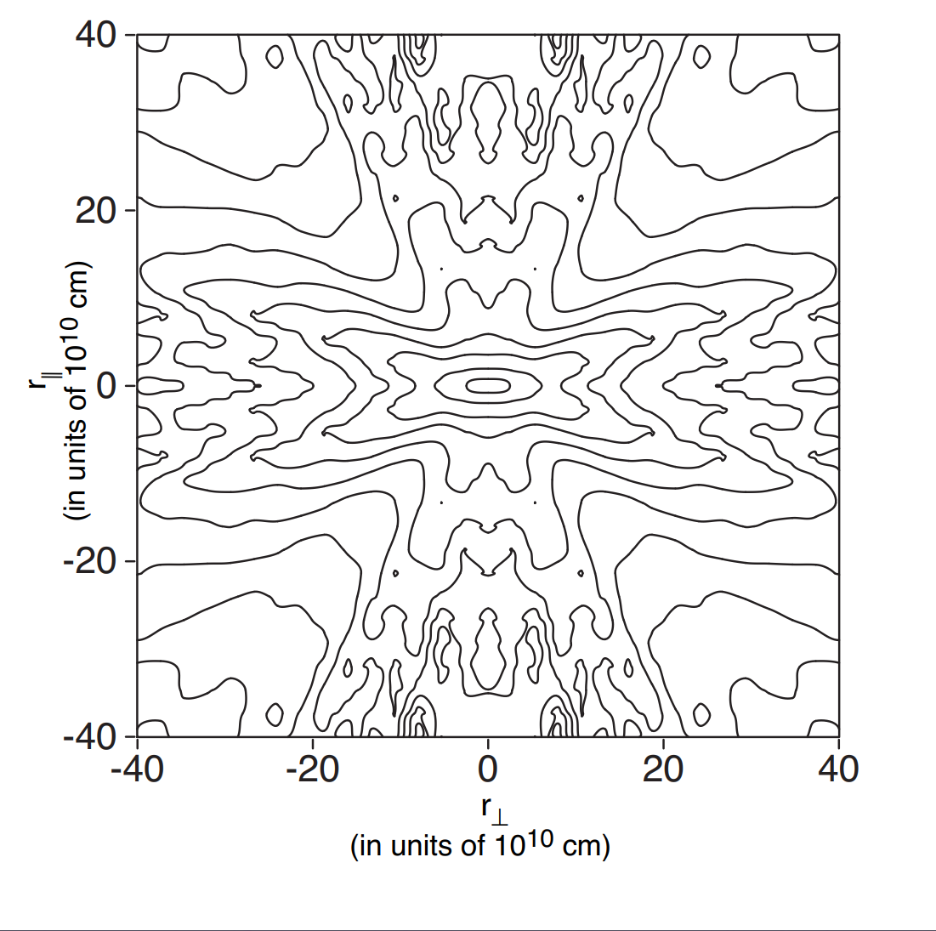
Contour plot of the two-dimensional correlation function of solar wind fluctuations
Image Credit: Matthaeus et al. 1990

Slide 35
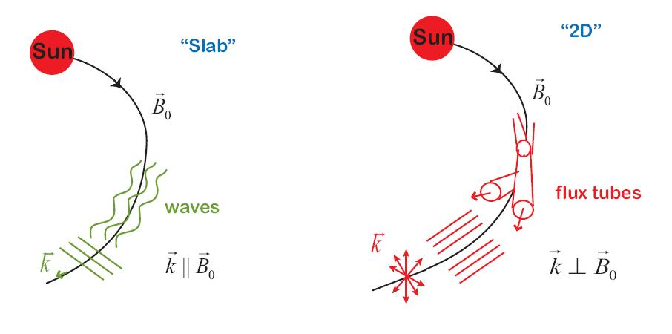
Schematic of populations of fluctuations in the solar wind
[Based on drawings by W. Dröge]

Slide 36
The 2D+slab Model of Magnetic Field Turbulence
$$Mean field: B_{0}\hat{z}$$
$$\vec{Β}={\vec{Β}}_{0}+\vec{b}(x,y,z)$$
$$transverse fluctuation:\vec{b}⊥{\vec{B}}_{0} \\ \vec{b}={\vec{b}}^{slab}\left(z\right)+{\vec{b}}^{2D}\left(x,y\right)$$
This model provides a useful description of magnetic
fluctuations in solar wind (Matthaeus et al. 1990, Bieber et al. 1996).

Slide 37
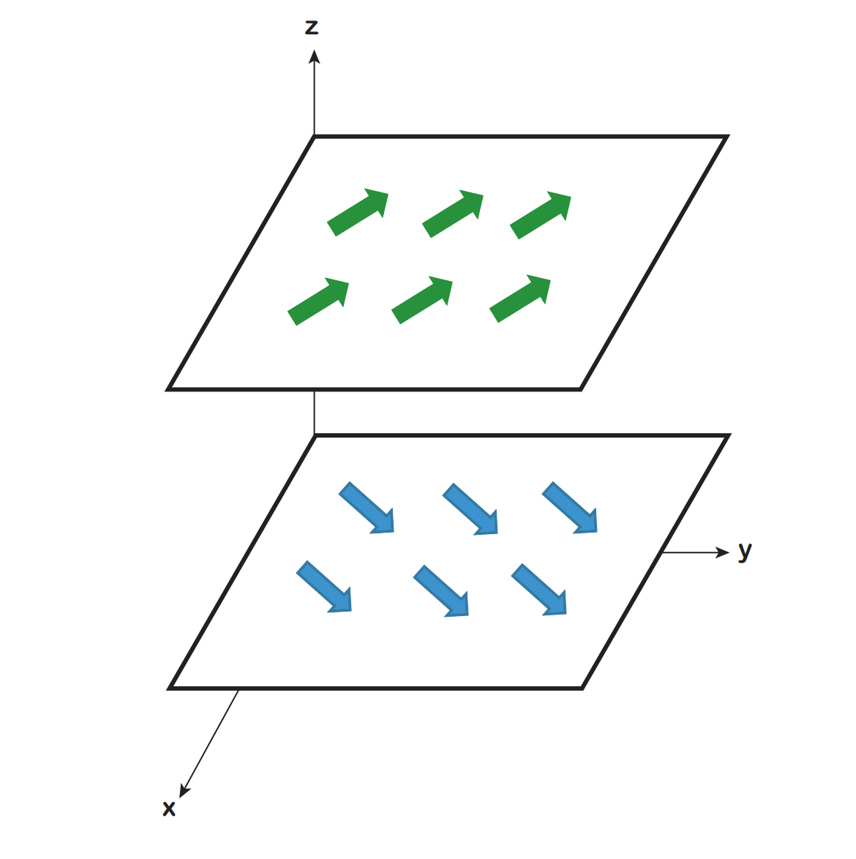
Slab Turbulence
$${\vec{b}}^{slab}(z)=b_{x}^{slab}(z)\hat{x}+b_{y}^{slab}(z)\hat{y}$$
The Fluctuation depends on z direction

Slide 38
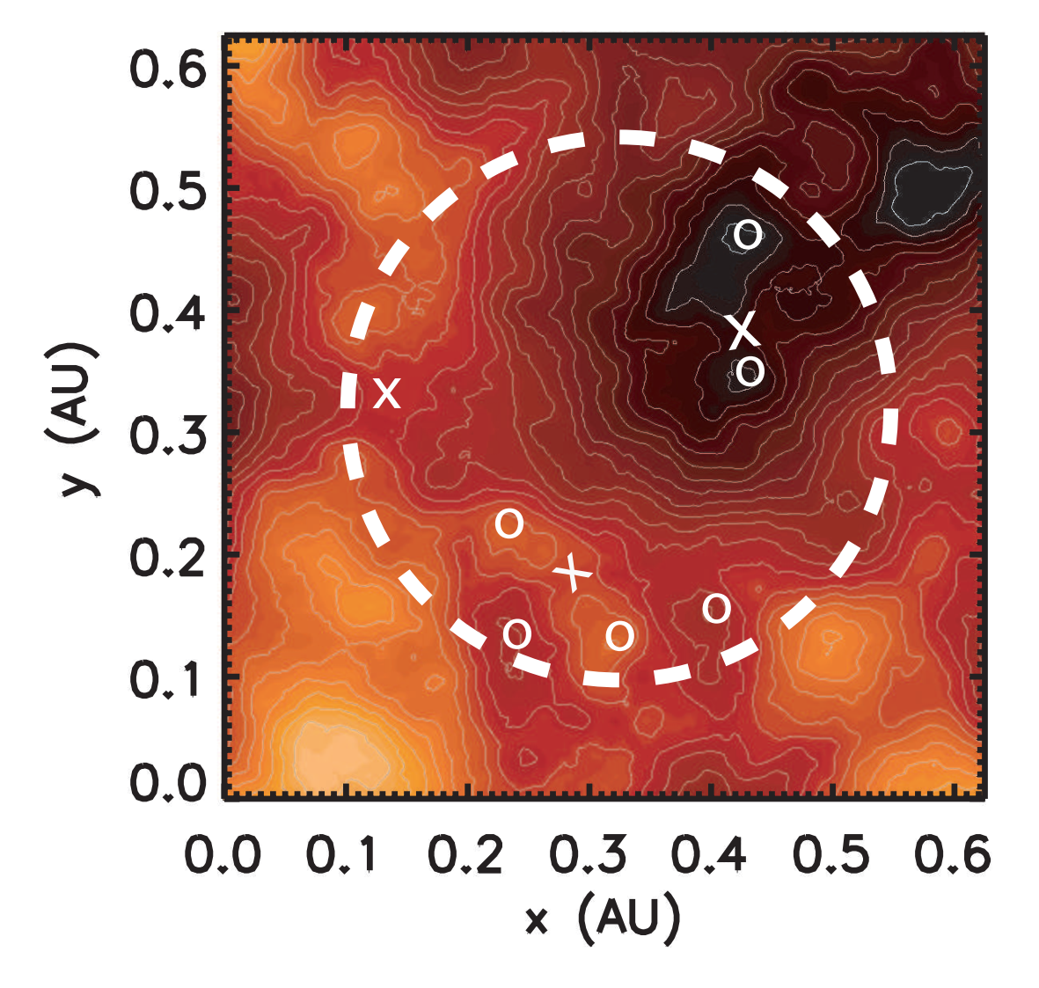
2D Turbulence
$${\vec{b}}^{2D}(x,y)=b_{x}^{2D}(x,y)\hat{x}+b_{y}^{2D}(x,y)\hat{y}$$
The fluctuation depend on x and y direction.
In general,
where is the vector potential
$${\vec{b}}^{2D}=\vec{∇}×a(x,y)\hat{z}$$
$$a(x,y)\hat{z}$$
Image credit: Chuychai et al. 2007

Slide 39
NUMERICAL SIMULATIONS
Streamline Code
Based on Dr. Piyanate Chuychai Streamline Workshop Lecture

Slide 40
Brief Description of the Project:
This code is a parallel implementation of a versatile algorithm for computation of streamlines, magnetic field lines or charged particle trajectories.
Each of these has in common that a set of generalized “trajectories” is generated, beginning from a set of specified initial conditions.
The trajectories are generated by integrating a set of ordinary differential equations (ODE's) - either three (for streamlines and field lines) or six (for charged particle orbits). In each case one or more vector fields must be specified; these appear as coefficients in the ODE's.

Slide 41
Physically what is required is
Streamlines: specify a velocity field and an initial position
Magnetic Field Lines: specify a magnetic field and an initial position
Charged Particle Orbits: specify a magnetic field, and electric field, and an initial position and velocity

Slide 42
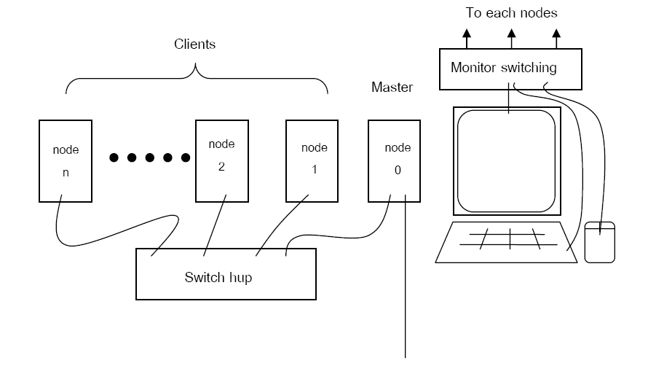
Cluster

Slide 43
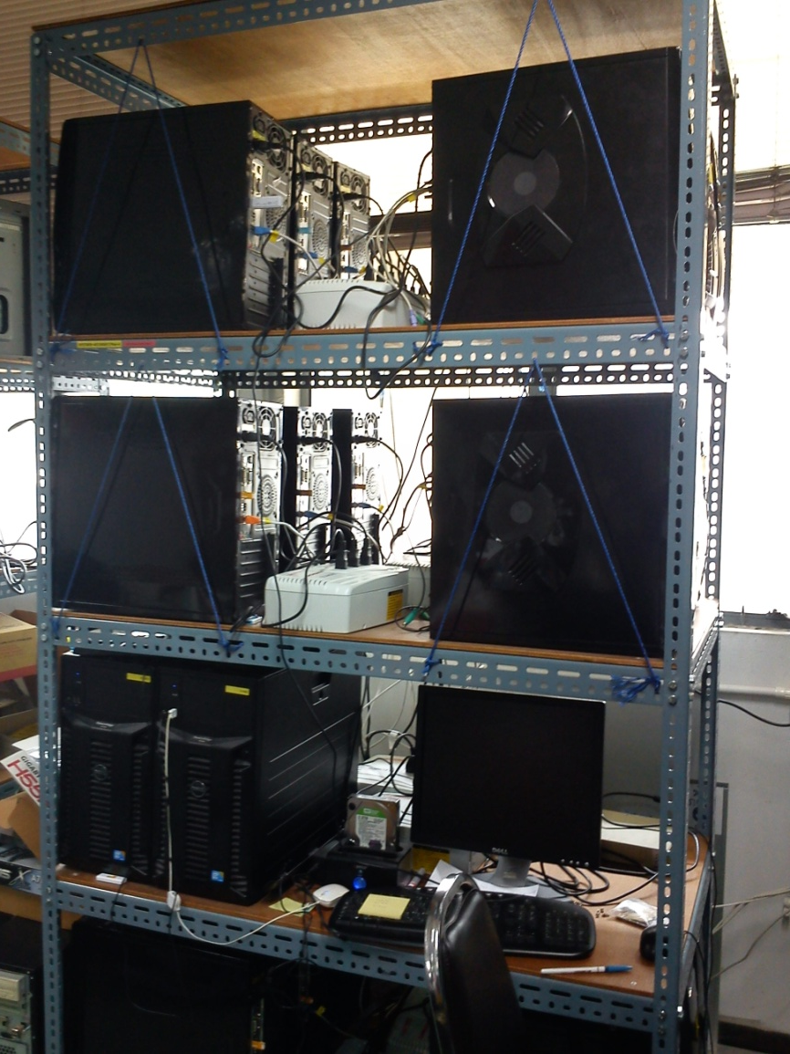
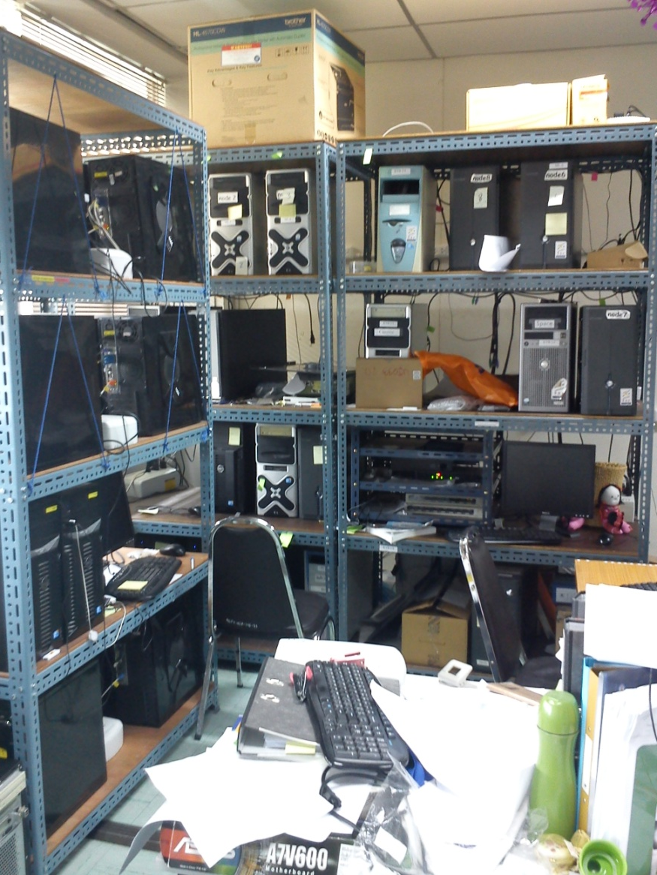
Cluster @ Space Physics and Energetic Particle Laboratory [2014]

Slide 44
Structure of program
INPUT
SOURCE CODE:
MPI in C [for parallel computing propose]
FORTRAN code [for scientific propose]
make
Makefile
EXE file: streamline
Run
OUTPUT

Slide 45
SOURCE CODE
MPI in C
fileoperation.c, getnewjob.c, myodestep.c, stream.c
FORTRAN CODE
derivs.for
emfldsXX.for
loadcommon.for
odestep.for
rkcs.for
Others: mhdflds.for, lint.for, gasdev.for, kloc3.for

Slide 46
INPUT:
• Magnetic field parameters: δB / B₀, B₀, l_{z}, l⊥, E_{2D} : E_{slab}, etc.
Size of simulation box and numbers of grid points. • Initial position of each particle or field line.
• Numbers of particles (N_{p}) or field lines (N_{f}). • Desired step size and accuracy.
Generate slab magnetic field
Generate 2D magnetic field
Solve equations of motion of particle or equation of field lines in Cartesian by 4th Runge-Kutta method with adaptive step size control
Positions (x,y,z) in Cartesian coordinates of each particle or field line.
Using parallel programming with MPI implementation technique
Analyze the data from the simulation

Slide 47
How to generate the slab turbulent magnetic field
Slab Field
Generate
Inverse fast Fourier transform
b^{slab}(z)
Power spectrum
Random phase
$${b_{i}}^{slab}(k_{z})=\sqrt{P_{ii}(k_{z})}e^{iφ(k_{z})}$$

Slide 48
How to generate the 2D turbulent magnetic field
2D Field
Generate
Inverse fast Fourier transform
2D random-phase magnetic potential
MHD code (by collaborator at U. Delaware)
2D MHD magnetic potential
b^{2D}(x,y) for Cartesian coordinates
Power spectrum
Random phase
$$a(k_{x},k_{y})=\sqrt{A(k_{x},k_{y})}e^{iφ(k_{x},k_{y})}$$
Option!
$$a(x,y)$$
$$a(x,y)$$

Slide 49
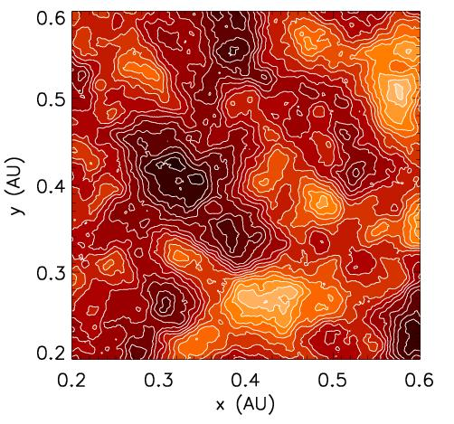
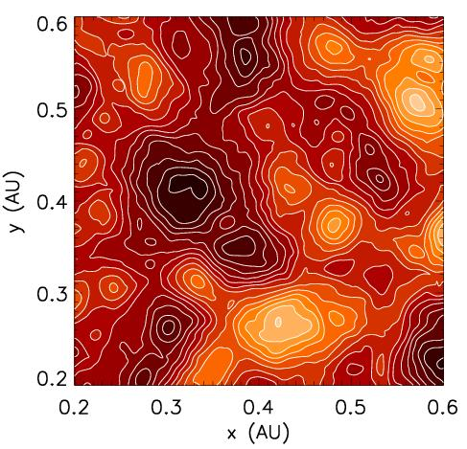
Contour plot of for a representation of 2D turbulence
$a(x,y)$
2D random-phase
2D MHD

Slide 50
Equation for field lines
Streamline equation:
We have
where

Slide 51
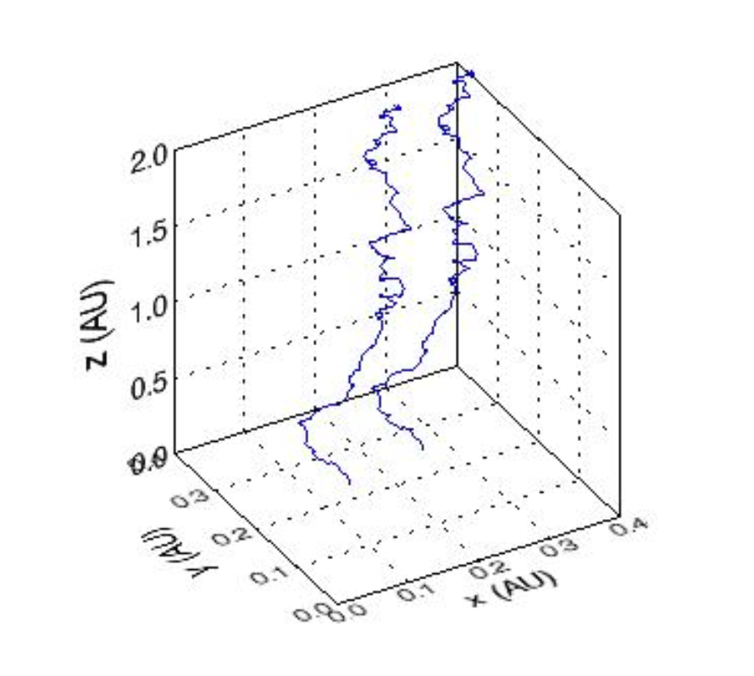
Two trajectories of magnetic field lines in pure slab turbulence
$$\vec{B}=B_{0}\hat{z}+{\vec{b}}^{slab}(z)$$

Slide 52
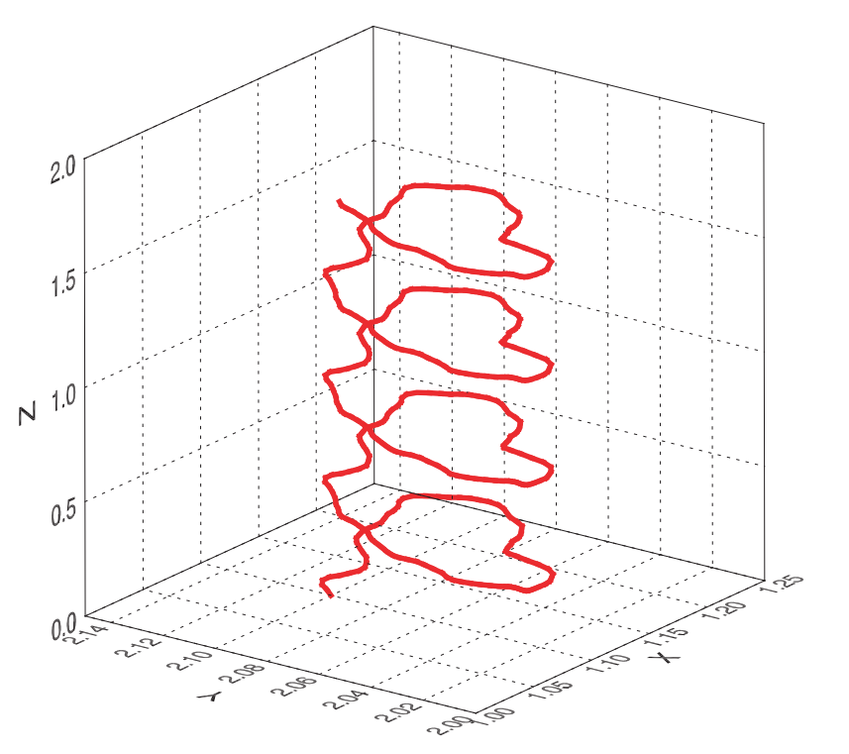
A trajectory of magnetic field line in pure 2D
$$\vec{B}=B_{0}\hat{z}+{\vec{b}}^{2D}(x,y)$$
Image credit: Tooprakai 2008

Slide 53
Equation for particles

Slide 54
Calculation of gyro-radius and gyro-frequency
Gyro-radius
Gyro-frequency

Slide 55
Gyro-frequency of protons at various energies for B = 5 nT from theory and simulations
Energy (MeV) | Gyro-radius, Theory (AU) | Gyro-radius, Simulation (AU) | Gyro-frequency, theory (rad/s) | Gyro-frequency, simulation (rad/s)
1 | 0.000193 | 0.000198 | 0.478 | 0.466
10 | 0.000612 | 0.000622 | 0.474 | 0.466
100 | 0.001981 | 0.002005 | 0.433 | 0.428
1000 | 0.007558 | 0.007691 | 0.232 | 0.228

Slide 56
Steps for Simulation
Source file directory [testrun]
1. Create execute file
Output file directory [mag / par1Mev / etc.]
2. Edit INPUT files
3. Run
$ make
$ nano filename
$ mpirun –np 5 ../streamline &

Slide 57
INPUT
data initial position, velocity
double_values
int_values
setup

Slide 58
data
Magnetic field lines
No. | x | y | z | x | y | z
Particles
No. | x | y | z | v_{x} | v_{y} | v_{z}

Slide 59
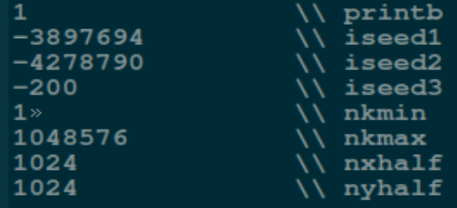
int_values
iseed1
iseed2
iseed3

Slide 60
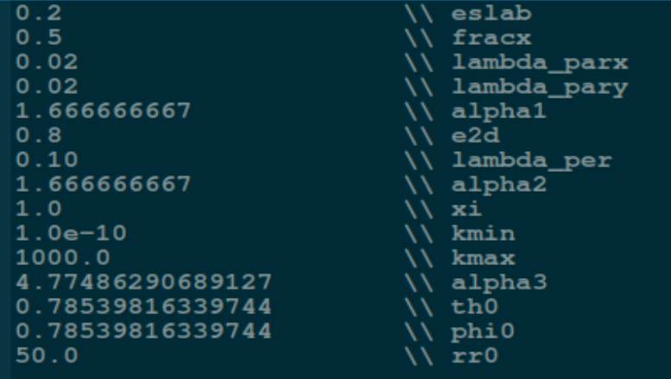
double_values
eslab
e2d
alpha3

Slide 61
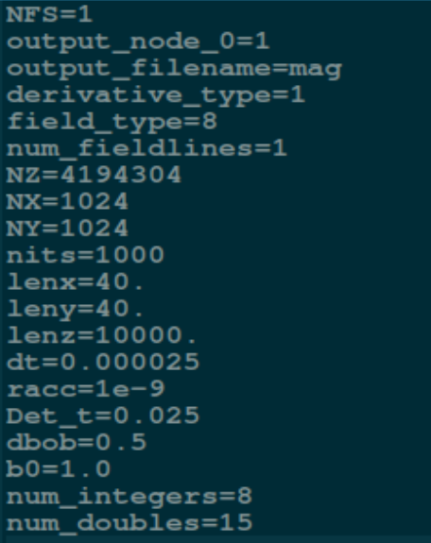
setup
output_filename
derivative_type
Magetic field = 1
Particle = 2
field_type
nits
Det_t
dbob

Slide 62
Workshop Simulations
Magnetic field lines in pure slab magnetic field
Magnetic field lines in pure 2D magnetic field
Magnetic field lines in 2D+slab magnetic field
Particles in a constant magnetic field
Particles in pure slab magnetic field
Particles in pure 2D magnetic field
Particles in 2D+slab magnetic field

Slide 63
APPLICATIONS TO RESEARCH

Slide 64
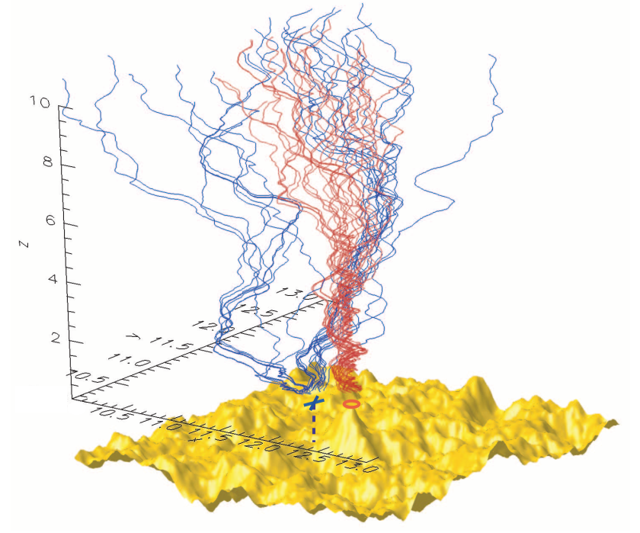
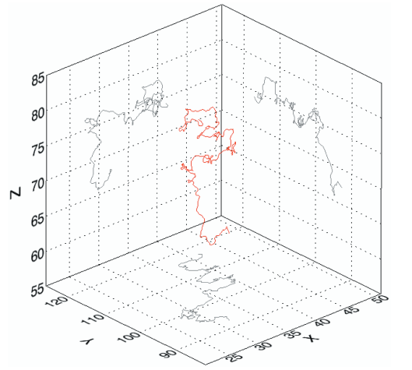
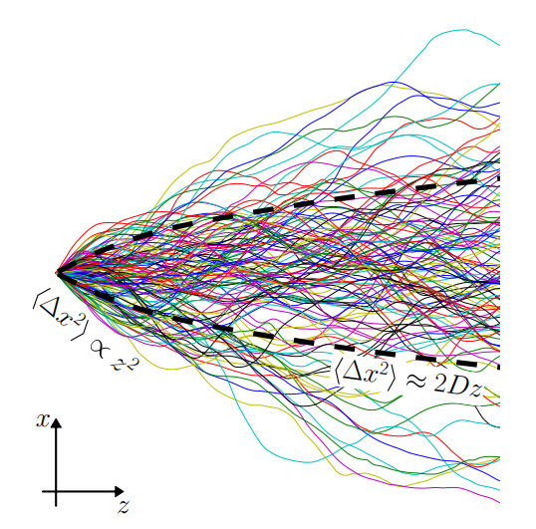
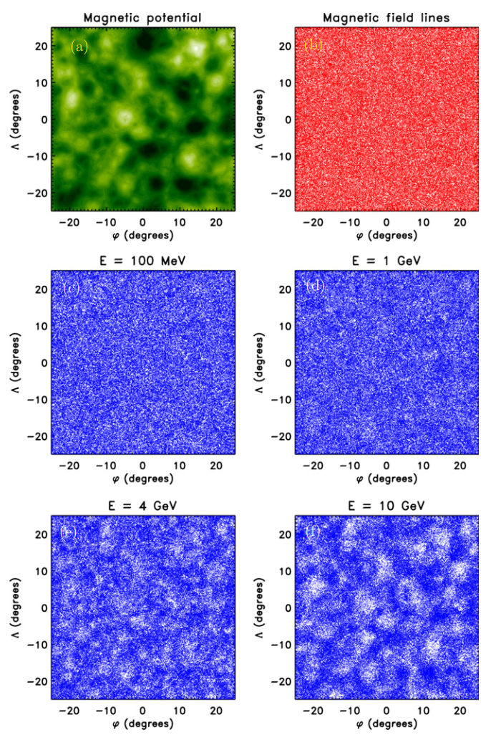
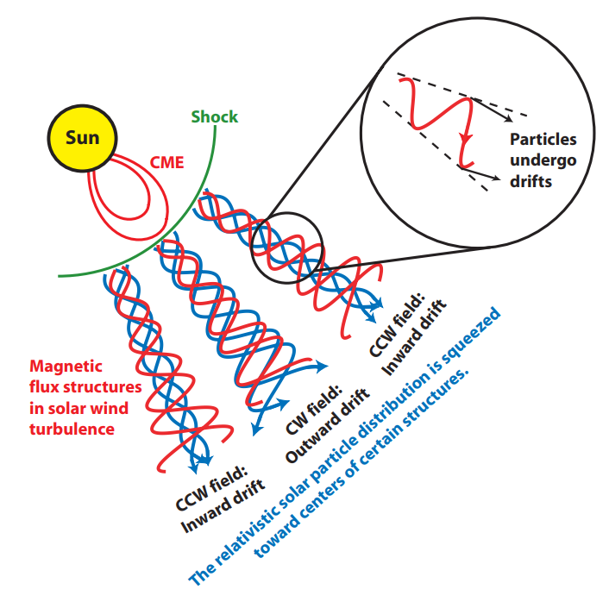
Publications
Ruffolo et al. 2003
Ruffolo et al. 2004
Chuychai et al. 2005
Chuychai et al. 2007
Tooprakai et al. 2007
Ruffolo et al. 2008
Seripienlert et al. 2010
Ghilea et al. 2012
Ruffolo et al. 2012
Snodin et al. 2013a
Ruffolo and Matthaeus 2013
Snodin et al. 2013b
Ruffolo et al. 2013
Sonsettee et al. 2015
Ruffolo and Matthaeus 2015
Tooprakai et al. 2016

Slide 65
Dropout phenomena from observations
What are dropouts?
Dropouts refer to discontinuous data where
the intensity of SEPs repeatedly disappears
and reappears.

Slide 66
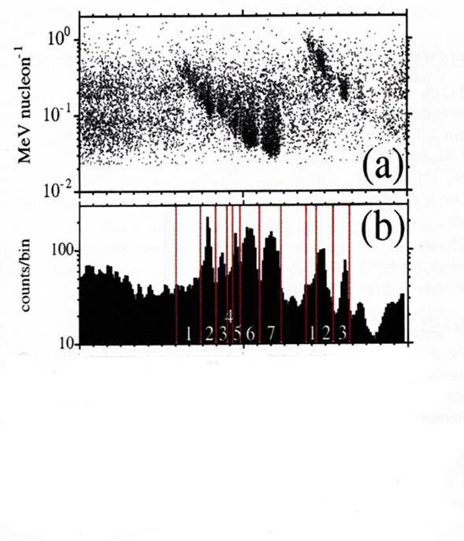
Observations from Advanced Composition Explorer (ACE) [Mazur et al. 2000]
a) Energy of H-Fe ions (in units of MeV nucleon⁻¹) vs. arrival time at 1 AU for the impulsive flare event of 1999 January 9.
b) H-Fe counts vs. time in smoothed, ~14 minute bins.
Observations from ACE showed the SEPs near Earth repeatedly disappears and reappears, indicating a filamentary distribution of SEPs and little diffusion across these boundaries.
date
1/9/1999 1/10/1999 1/ 11/1999
Image credit: Mazur et al. 2000

Slide 67
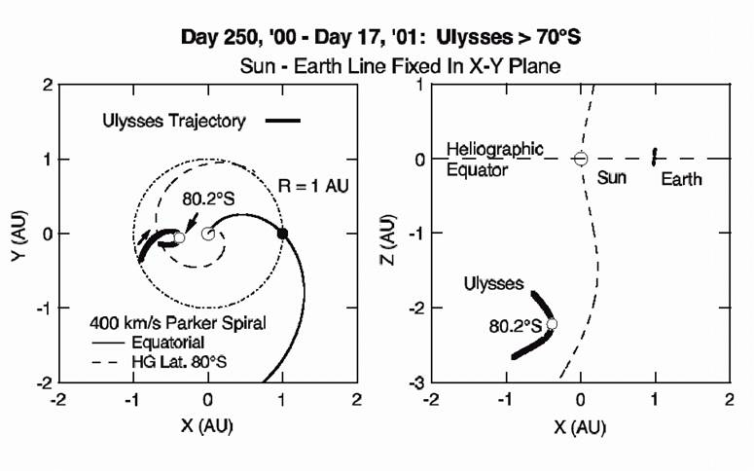
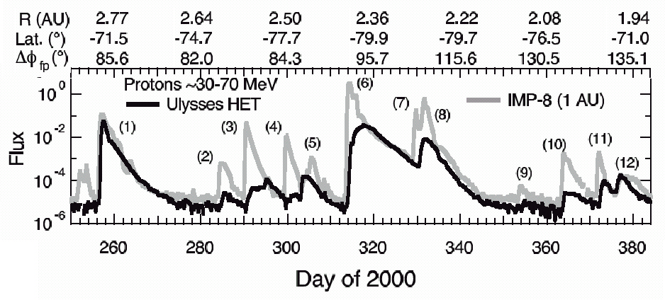
Observations from Interplanetary Monitoring Platform 8 (IMP- 8)
near Earth and Ulysses at 2-2.8 AU from the South pole of the Sun
[McKibben et al. 2001]
Observations from
the IMP-8 and
Ulysses spacecraft
indicate that the
particles undergo
substantial lateral
diffusion,
spreading
throughout the
entire inner solar
system within a
few days.

Slide 68
A paradox observations of SEPs
ACE spacecraft
Ulysses and IMP-8
SEPs from impulsive solar flares can exhibit “dropouts.”
The density of SEP in space is highly inhomogeneous.
This seems to imply very little lateral diffusion.
SEPs spread throughout
the entire inner solar.
system within a few days.
Rapid lateral diffusion
of magnetic field lines.

Slide 69
Topological trapping (Ruffolo et al. 2003)
They considered a two-component model for the magnetic field turbulence, motivated by observations of solar wind turbulence (Matthaeus et al. 1990).
They suggested the idea of conditional statistics to explain the contradictory observations.
Their idea can explain both the ACE observations of dropouts and the IMP-8/Ulysses observations of rapid diffusion of SEPs under normal solar wind conditions.

Slide 70
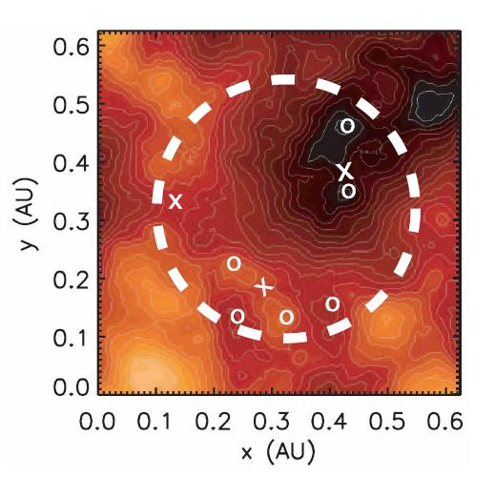
Conditional Statistics
O-points are local minima or maxima
X-points are saddle points of a(x,y)
Over an intermediate distance scale:
The field lines near the O-points are temporarily trapped.
The field lines near the X-points spread rapidly in the lateral directions.
Topological trapping!
Over a long distance scale:
All magnetic field lines have escaped their temporary topological traps and undergo substantial lateral diffusion.
Image credit: Chuychai et al. 2007

Slide 71
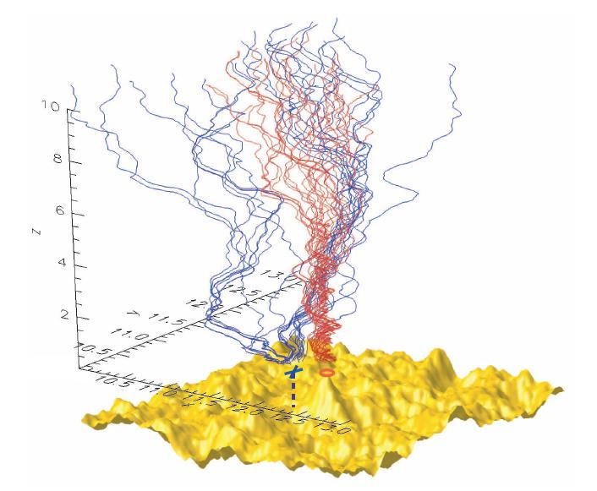
Conditional Statistics
Blue lines: field lines that start near an
X-point
Red lines: field lines that start near an
O-point
4.00
Z (AU)
2.00
1.00
0.50
0.25
0.00
Image credit: Chuychai et al. 2007
Notes:
15/1/2008
71

Slide 72
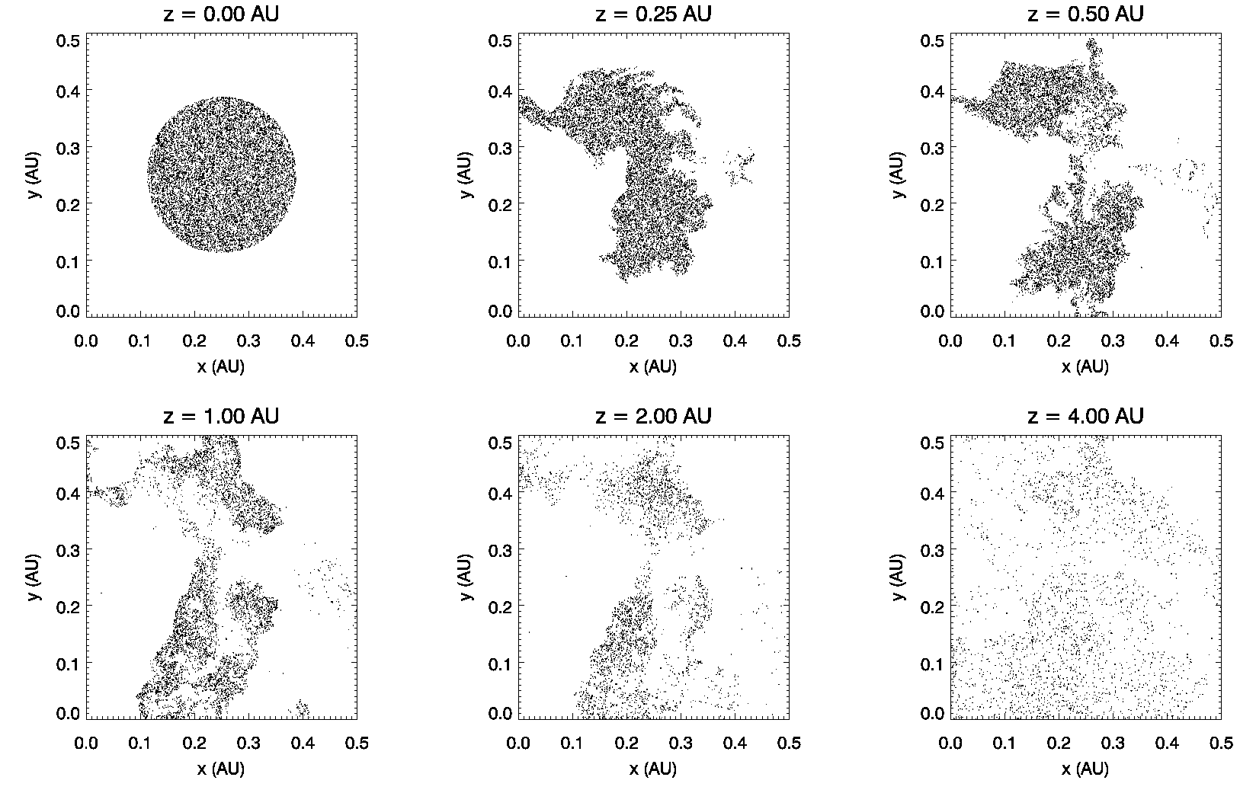
Numerical results: scatter plots of field lines at various z

Slide 73
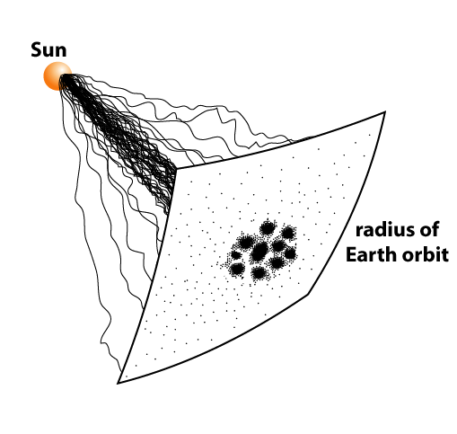
“core” of SEP with dropouts
“halo” of low SEP density over
wide lateral region

Slide 74
Local Trapping Boundaries in a 2D MHD + slab field

Slide 75
Local trapping boundaries (Chuychai et al. 2007)
In 2D+slab turbulence, the field lines near O-points are temporarily trapped “near a local 2D islands.”
how to define “near a 2D island?”
The field lines are sometimes trapped within a sharp boundary that has a maximum of averaged |b^{2D}|².

Slide 76
Local Trapping Boundaries (LTBs)
What are local trapping boundaries (LTBs)?
Equipotential contours that have maximum of average 2D fluctuation energy compared with neighbouring contours:
Maximize:

Slide 77
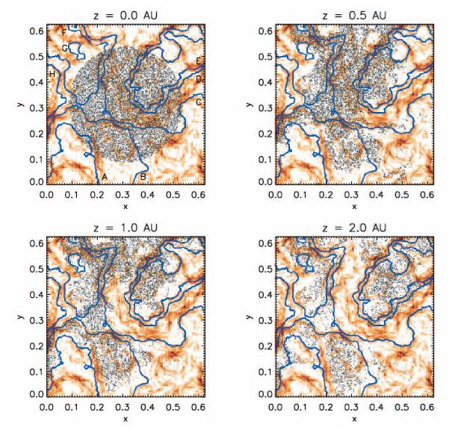
LTBs
Scatter plots of magnetic field-line trajectories in 2D+slab turbulence at various distances z.
The blue curves are the LTBs.
The red shading indicates the value of |b^{2D}|².
Image credit: Chuychai et al. 2007

Slide 78
Seripienlert et al. 2010
Introducing 2D MHD in the model and compare with 2D random-phase which is more realistic model of turbulence fluctuation in the solar wind.
Study some characteristic of 2D MHD model.

Slide 79
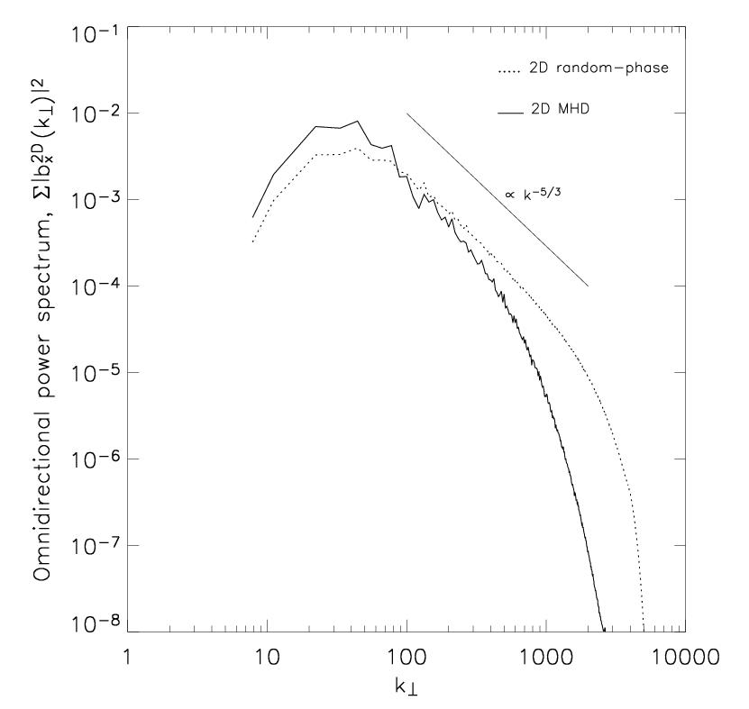
Comparison of power spectrum between
two models of 2D field.

Slide 80
Moment distribution calculation
4th moment (kurtosis)
6th moment
3 for a Gaussian
15 for a Gaussian

Slide 81
Moments of Various Quantities for Magnetic Field Models
Model | Quantity | 4th moment | 6th moment
Slab | b_{x} | 3.02 | 15.43
 | b_{y} | 2.95 | 14.36
2D random-phase | a | 3.04 | 14.51
 | b_{x} | 3.06 | 15.94
 | b_{y} | 2.93 | 14.98
 | j_{FD} | 3.01 | 15.18
2D MHD | a | 3.04 | 14.50
 | b_{x} | 2.76 | 12.37
 | b_{y} | 2.67 | 11.02
 | j_{FD} | 7.65 | 331.3
 | j | 6.80 | 242.1

Slide 82
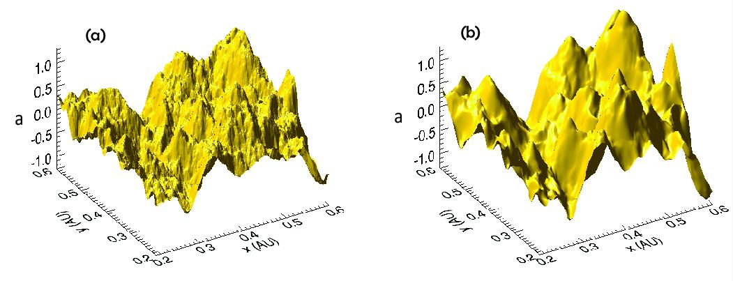
Comparison 3D surface plots between two models: magnetic potential
2D random-phase
2D MHD

Slide 83
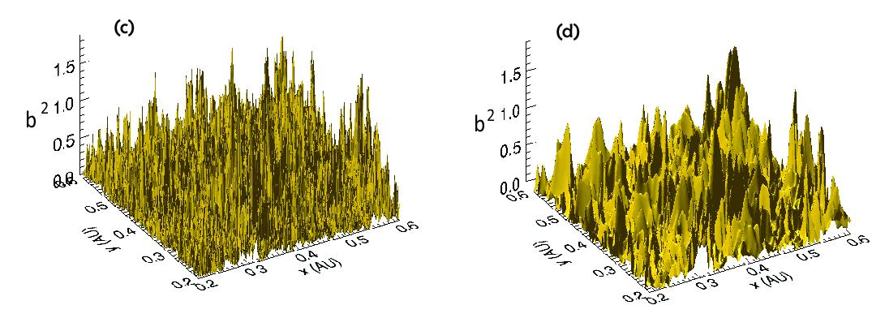
Comparison 3D surface plots between two models: |b²|
2D random-phase
2D MHD

Slide 84
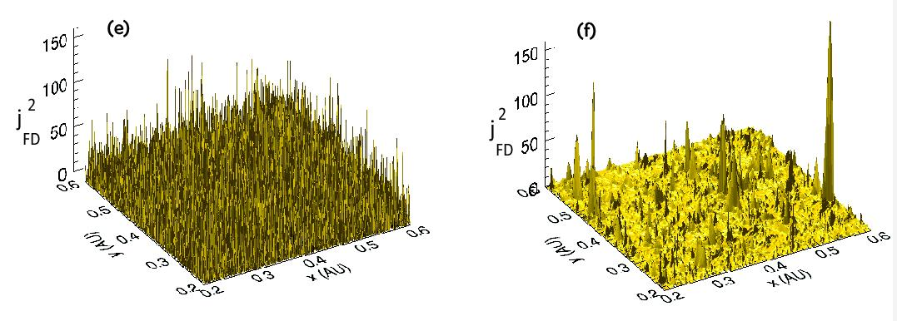
Comparison 3D surface plots between two models: current
2D random-phase
2D MHD

Slide 85
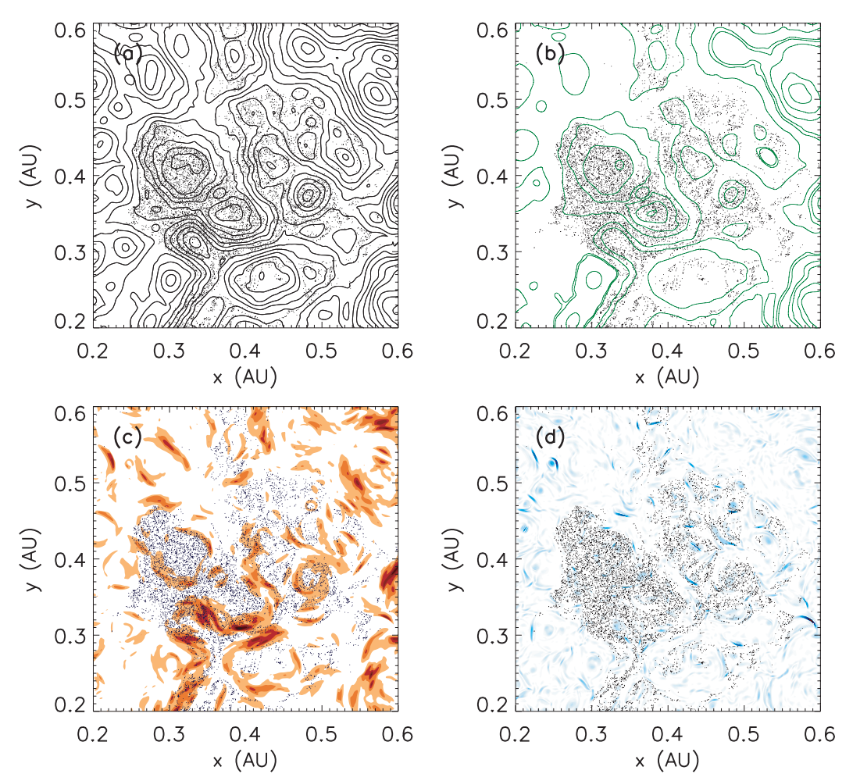
Scatter plots of magnetic field trajectories at z = 1.0 AU.
(a) with contour lines
(b) Green lines indicate LTBs.
(c) Red shading indicate |b|²
(d) Current sheets located at blue patches.

Slide 86
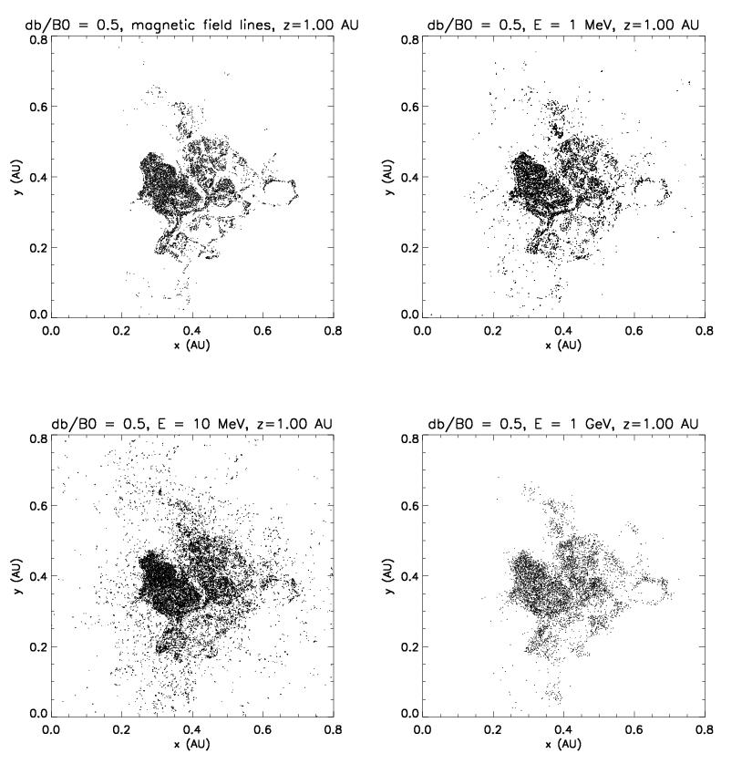
Comparison trajectories between magnetic field lines and particle.
Scatter plots of magnetic field lines and particle trajectories in 2D MHD+slab turbulence at
z = 1.0 AU.

Slide 87
Summary of LTBs work
We found that particles of energy < 10 GeV
following magnetic field lines closely, so we
can use magnetic field trajectories as
proxies for particle trajectories for dropout
features.
LTBs are more associated with dropout
features than current sheets.

Slide 88
Squeezing of Particle Distributions by Expanding Magnetic Turbulence

Slide 89
Squeezing
Due to curvature drift and gradient drift
Collimation only for gyro-radius ~ scale of B variation

Slide 90
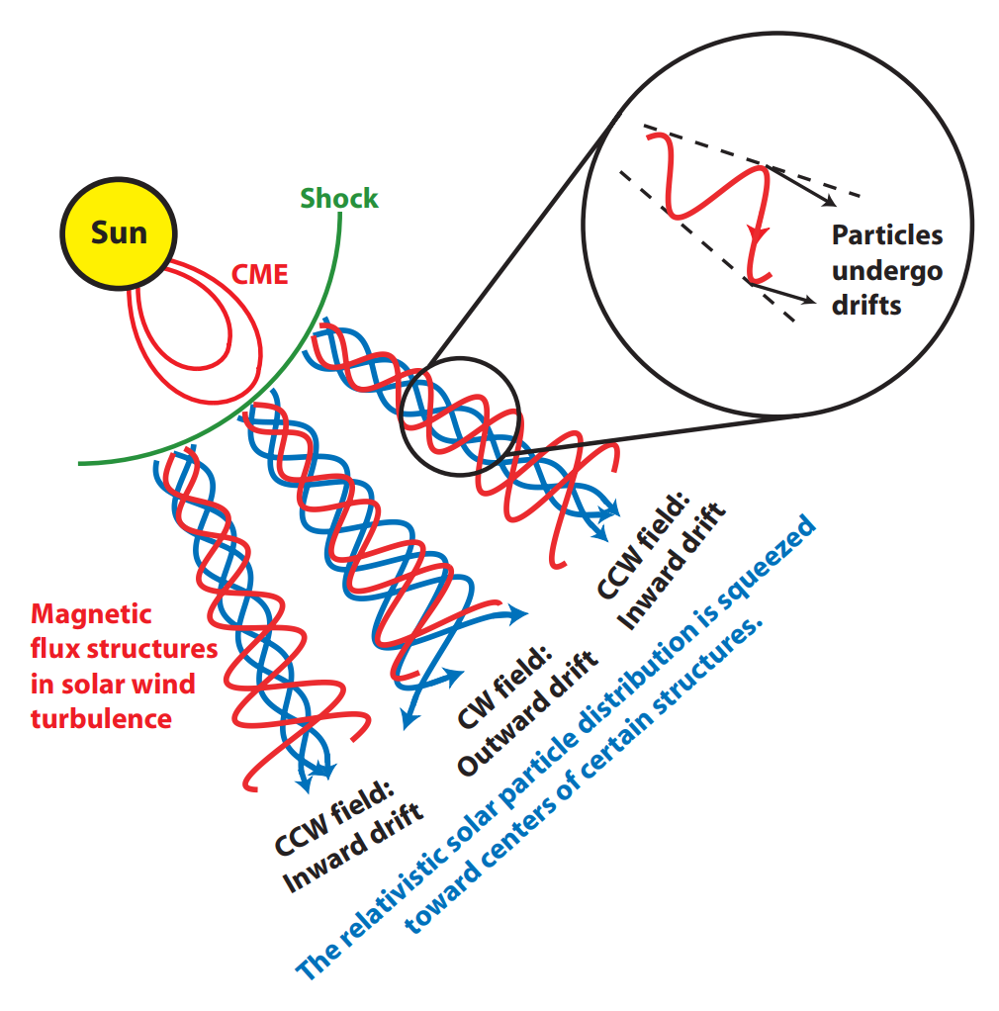

Slide 91
Squeezing of SEPs
(a) Magnetic potential function a vs. solar longitude ϕ and latitude Λ for a 2D MHD model of the 2D component of interplanetary magnetic turbulence.
(b) Magnetic field line locations at Earth’s orbit (r = 1 AU) as traced from 150,000 uniformly random initial positions at r = 0.1 AU from the Sun.
(c)–(f) Scatter plots of proton arrival locations at r = 1 AU for various energy

Slide 92
Summary of Squeezing Work
Solar energetic particles of < 1 GeV (energy where r_{g} < island size) follow field lines closely.
Positively charged particles of higher energy can be highly concentrated at potential maxima (qB₁ > 0) to form collimated beams due to guiding center drift.
Such particles are driven away from potential minima (qB₁ > 0)
The collimation may have observable effects on relativistic solar particles.
Notes:
SEP of energy that gyro-radius less than the island size will follow field lines closely.
Particle of higher energy can be accumulated at potential maxima to form collimation beam
this process caused by curvature drift
such particles are driven away from potential minima
the collimation may have observable effects on relativistic solar particles.

Slide 93
Magnetic Field Line Random Walk in Isotropic Turbulence with Zero Mean Field

Slide 94
Equation for Field Lines
where
defined

Slide 95
Diffusion coefficients
In terms of τ

Slide 96
Corrsin’s Independence Hypothesis

Slide 97
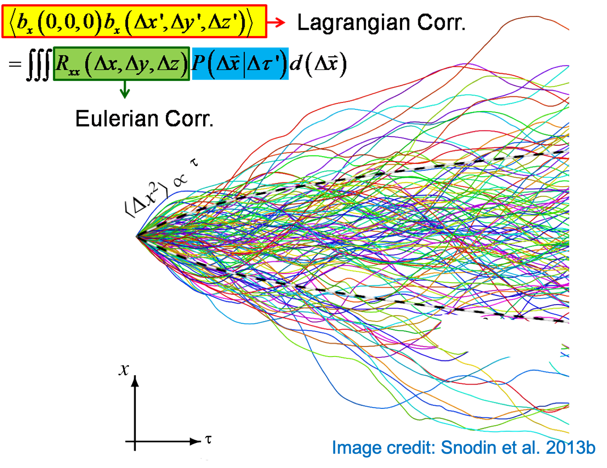

Slide 98
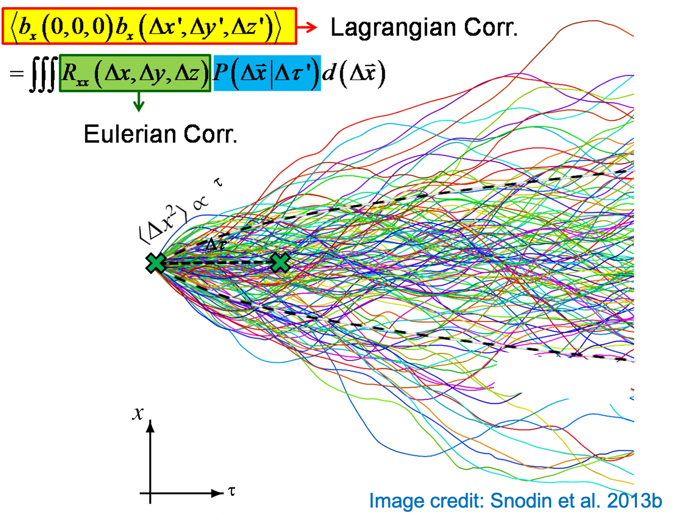

Slide 100
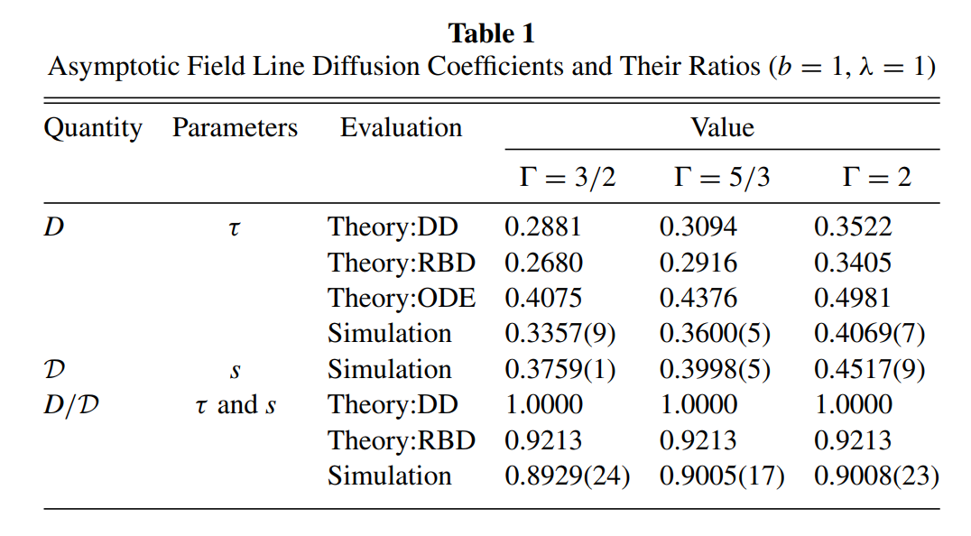
Asymptotic Field Line Diffusion Coefficients

Slide 101
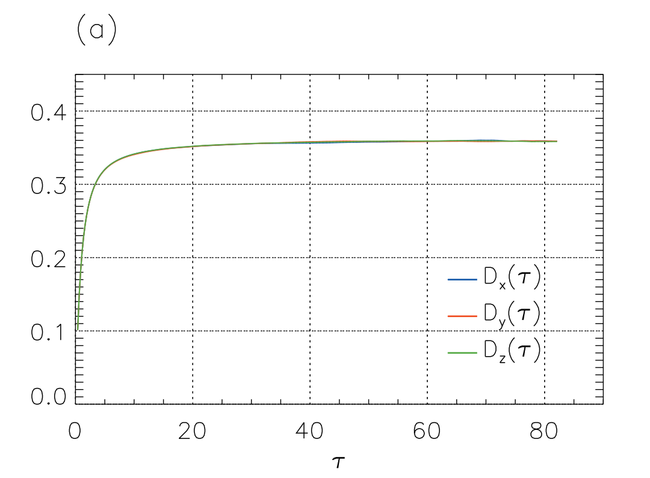
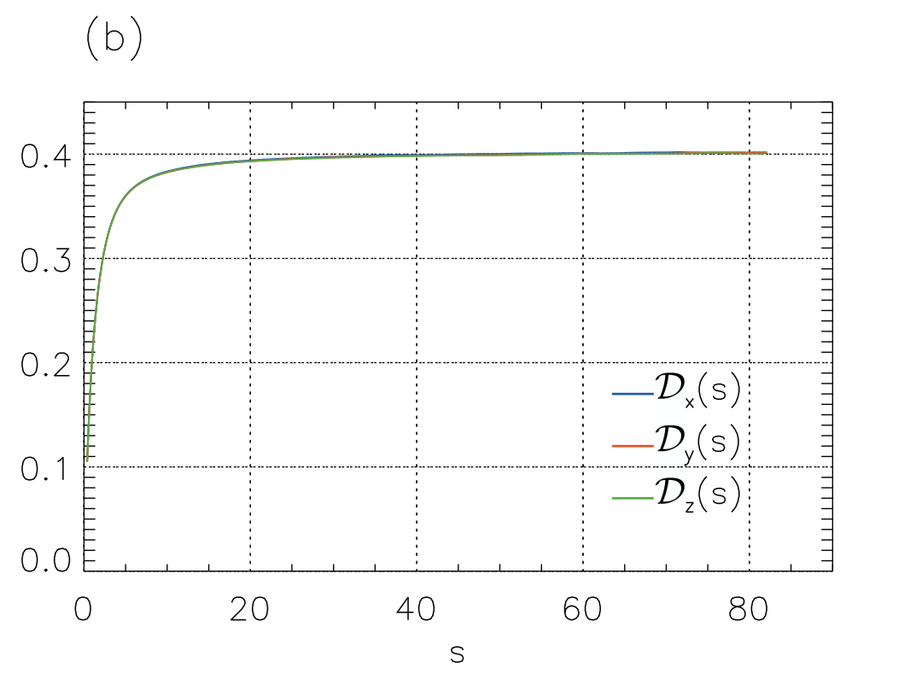
Magnetic field line diffusion coefficients as a function of (a) τ and (b) s

Slide 102
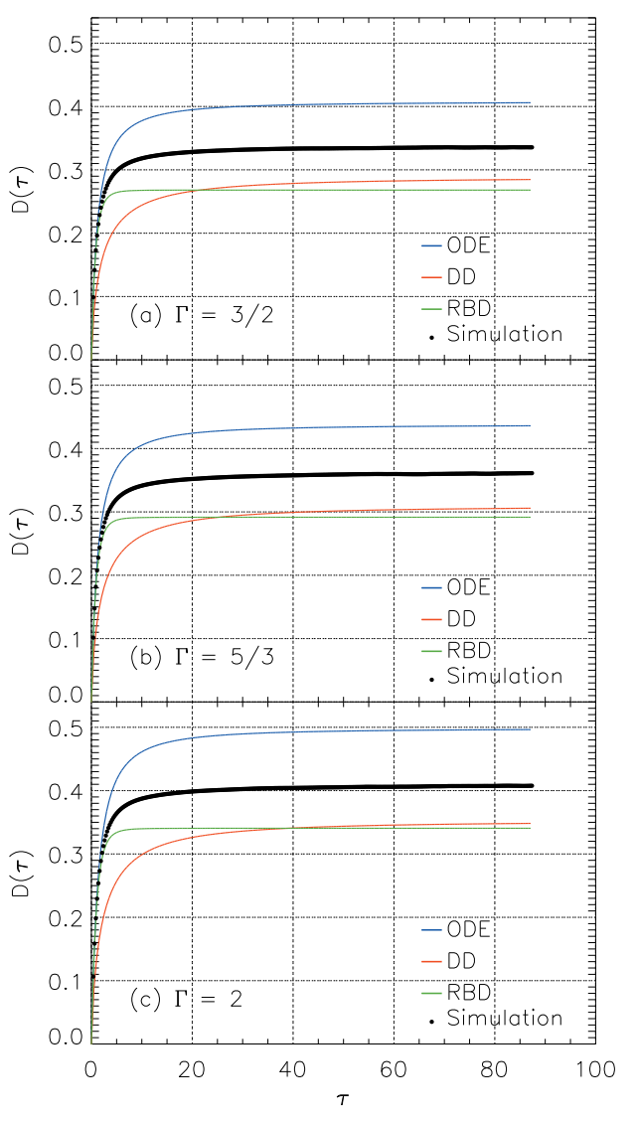
Magnetic field line diffusion coefficient as a function of τ from simulation and three versions of the analytic theory for b = 1, λ =1, and different choices for the spectral index of the fluctuation power spectrum.

Slide 103
ACKNOWLEDGEMENTS
We would like to thank
Research Center in Physics and Astronomy, Faculty of Science, Chiang Mai University.
National Astronomical Research Institute of Thailand.

Slide 104
THANK YOU FOR YOUR ATTENTION!

